Slide 1
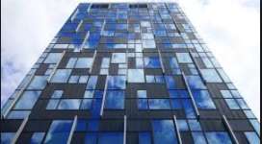
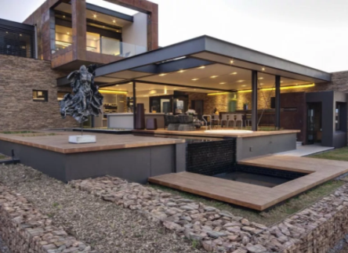




DANA KOREA CO., LTD
YOUR BEST CHOICE FOR YOUR BUSINESS PARTNER
Address : 2F, 88-10, WORLDCUP BUK-RO 6-GIL, MAPO-GU,
SEOUL, KOREA(ZIP:03993)
TEL : +82-2-3143-4070 / FAX : +82-2-3143-4233
E-MAIL : sales@danakorea.com

Slide 2
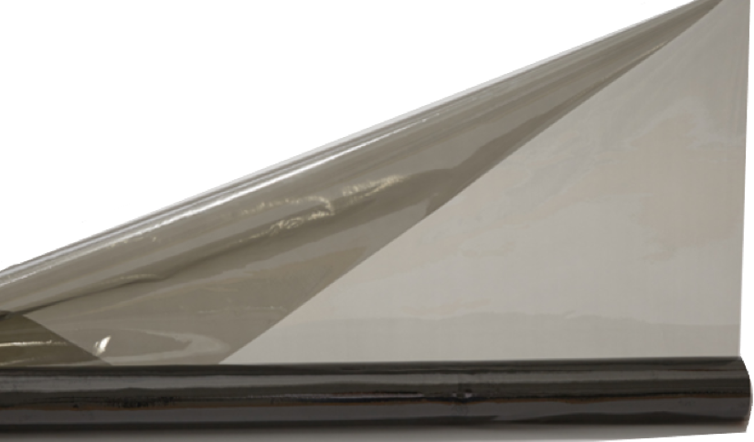
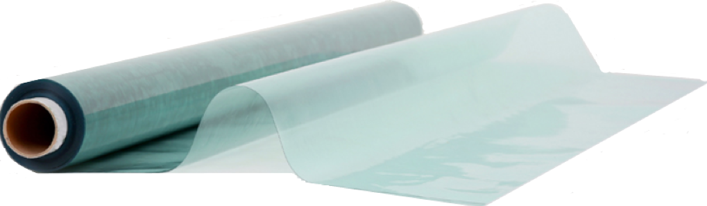
DANA KOREA CO., LTD
* Contents
I. Dana Korea History
II. Production Process of Insulation Film
III. Solution of Our Products(Insulation Film)
IV. Products – EZI Sheet & WaTouch Film
IV-1-1. Product 1. EZI Sheet - Introduction
IV-1-2. Effects(Over all) _ EZI Sheet
IV-1-3. Tests _ EZI Sheet
A. Heat Shielding Effects
B. Window Condensation prevention
C. OTHERS
IV-1-4. How To Use(Installation) _ EZI Sheet
IV-2-1. Product 2 – WaTouch Film - Introduction
IV-2-2. Effects & Tests _ WaTouch Film
A. Heat Shielding Effects & Window Condensation Prevention
B. OTHERES
IV-2-3. How To Use(Installation) _ WaTouch Film
V. Produced SIZES
VI. Business Area
VII. Test Reports
VIII. Our Abroad Partners

Slide 3
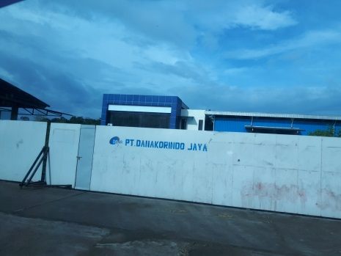
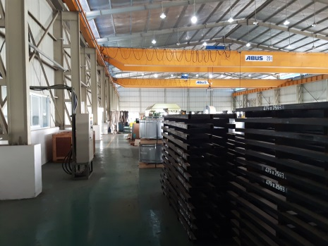
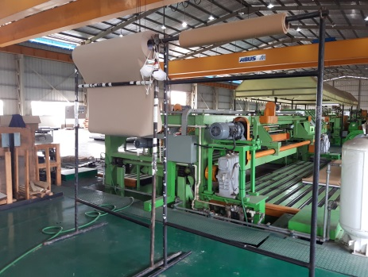
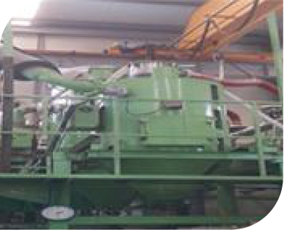
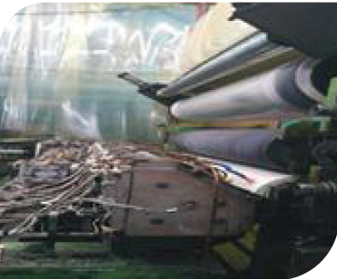
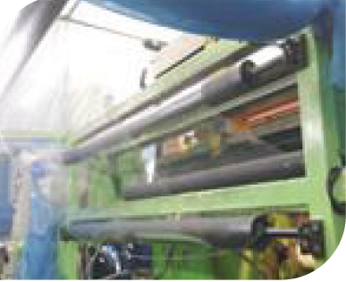
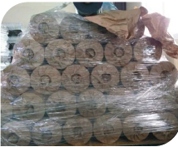
DANA KOREA CO., LTD
I. STEPS OF DANA KOREA
1998 Established Sunshine trading
2000 Open an office in Jakarta & Mumbai
2002 Change the company name to Dana Korea Co. Ltd.
Starting the business with Middle east country
2003 Open an office in Karachi office
2006 Open an office in Egypt
2011 Sales achievements US$30,000,000
2014 Set up Coil Center in Jakarta of Indonesia
PT Danakorindo Jaya(Capital: US$6,300,000)
Set up Golden Age World Co Ltd. (Capital : US$ 500,000)
2021 It will be getting sales achievements US$50,000,000
PT Danakorindo Jaya in Indonesia.
II. Production Process of Insulation Film,
Raw material combination
Molding / Rolling
Drying
Finished products

Slide 4
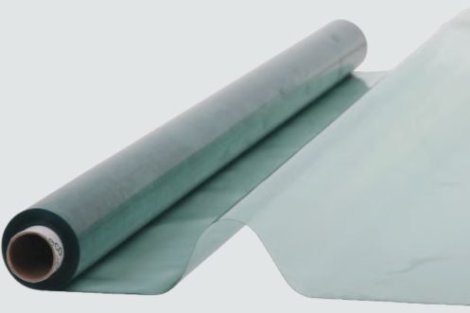
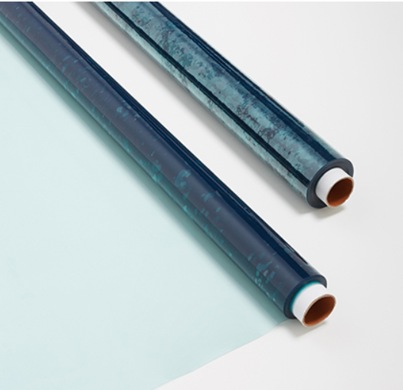
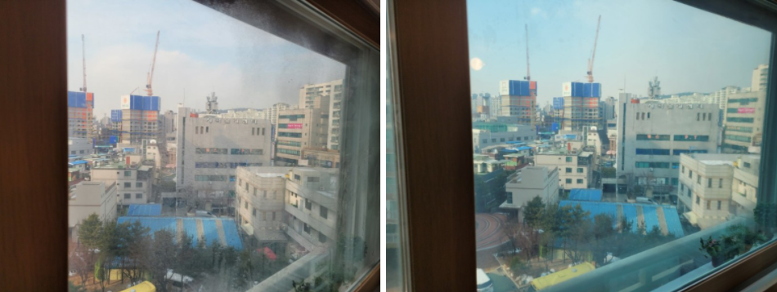
DANA KOREA CO., LTD
III. Solution of Our Products(Insulation Film)
During summer and winter season, films and air caps are used on the window to insulation heat from coming in(summer) or going out(winter). But, what customers really want is product that easy to DIY and efficient to install. That is why Dana Korea is presenting our product. Our products are a nano heat blocking sheet/film that needs only water to be attached itself to the window. By using water as ad adhesive(glue), our products are easy to reuse without wear out.
IV. Products – EZI Sheet & WaTouch Film
IV-1-1. Product 1. EZI Sheet - Introduction
1) The name of ‘EZI Sheet’ is came from the idea of ‘easy to attach’.
This ‘EZI Sheet’ is mainly used as DIY at home, without expert.
2) EZI Sheet is composed with ‘PVC + Nano Ceramic(ATO + CTO)’.
3) This EZI Sheet protects the UV rays simultaneously blocks the heat and
keep cool indoor.
4) The main color of EZI sheet is Green with transparency.
<EZI Sheet picture>
<Without EZI Sheet Attached> <With EZI Sheet Attached>

Slide 5





DANA KOREA CO., LTD
IV-1-2. Effects(Over all) _ EZI Sheet
Reducing air-conditioning energy cost
By blocking the heat and cold at the window
Efficient cooling/heating
Saving
electricity costs
2. Preventing skin aging & discoloration
Blocking UV prevents skin from diseases &
furniture discoloration.
Prevention of
skin aging
UV protection
3. Decreasing condensation and mold
Maintaining freshness by decreasing moisture
which causes respiratory disease.
Decrease condensation
Mold reduction
4. Easy to DIY
Attached only by water. Wrinkle free.
Saving labor costs,
Simple attachment
Semi-permanent use
5. Superior performance
It is semi-permanent or reusable, and completed
shatter-resistant prevention tests for various hazardous
substances.
Reusable
No harmful substances

Slide 6
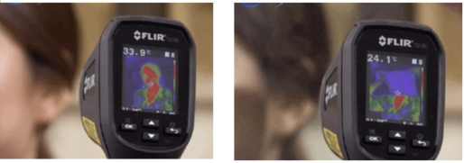
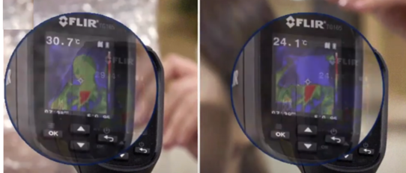
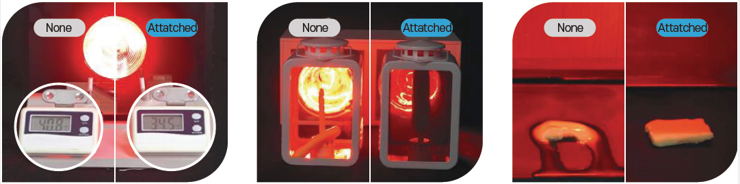
DANA KOREA CO., LTD
IV-1-3. Tests _ EZI Sheet
A. Heat Shielding Effects
<Without EZI Sheet Temperature> <With EZI Sheet Temperature>
* There is around 10˚ C difference, depending on existence of EZI Sheet.
<With Bubble Wrap Temperature> <With EZI Sheet Temperature>
* There is around 6˚C difference, depending on existence of EZI Sheet.
* Differences of result, depending on existence of EZI Sheet.

Slide 7
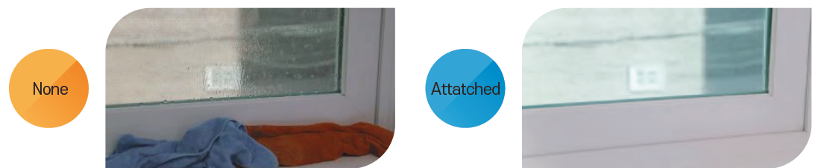
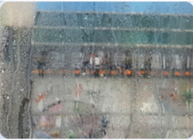
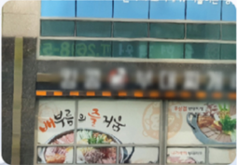

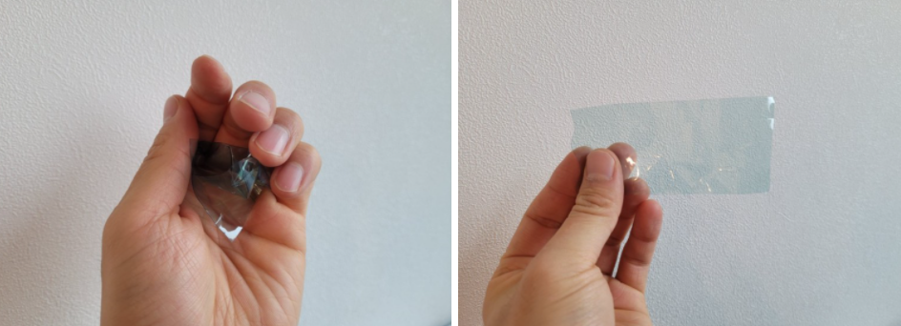
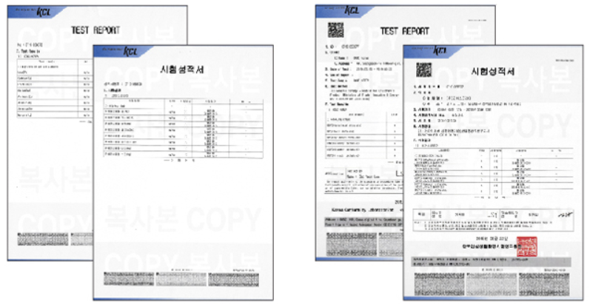
DANA KOREA CO., LTD
B. Window Condensation prevention
VS
<Window without EZI Sheet> <Window with EZI Sheet>
C. OTHERS
UV
98%
- EZI Sheet blocks over 98% of UV rays.
Re-usable
&
Excellent force of restitution
* Left
- Test Report of 8
major heavy metals
hazardous free.
* Right
- Test Report of 6
major phthalate free.

Slide 8

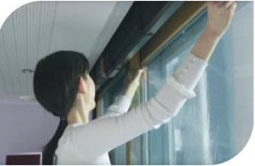
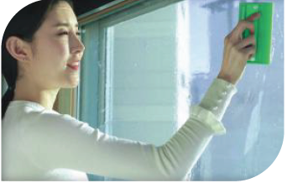
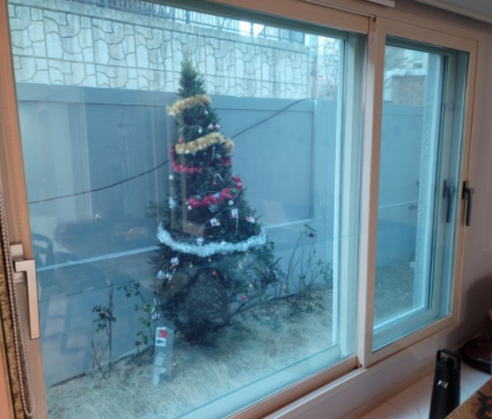
DANA KOREA CO., LTD
IV-1-4. How To Use(Installation) _ EZI Sheet
* Notice: Before following below steps, please clean the window first, for
better attaching result.
Step 1.
- Spray water to the window
overall.
Step 2.
- Attach the sheet from the top
to bottom after measured.
Step 3.
- Remove the air bubble with
Push stick, Cut off the remaining
film with box cutter.
Step 4.
- EZI Sheet is installed.

Slide 9
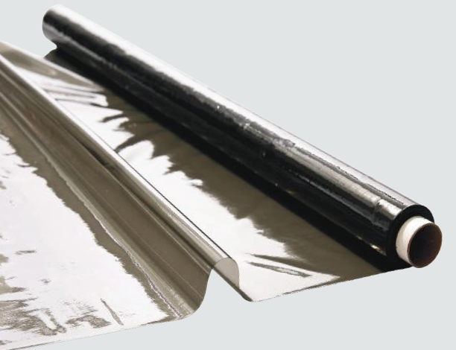
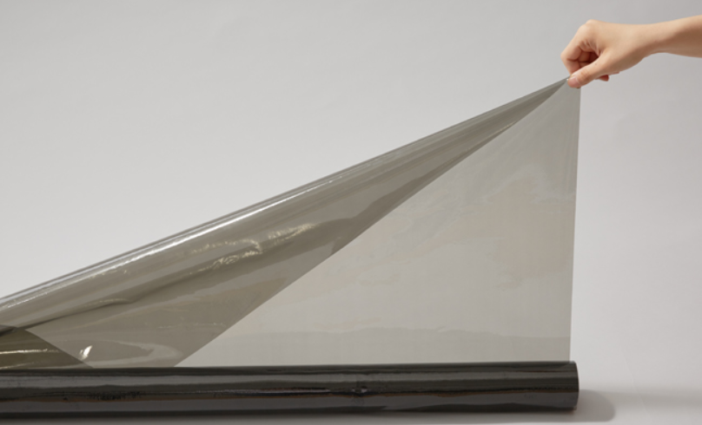
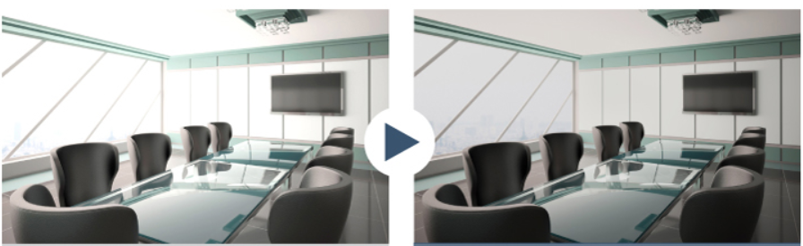
DANA KOREA CO., LTD
IV-2-1. Product 2 – WaTouch Film - Introduction
1) The name of ‘WaTouch Film’ is came from the idea of ‘Water + Touch’.
This ‘WaTouch Film’ is mainly used for buildings, large interior, on canopy and also
at home with expert.
2) WaTouch Film is composed with ‘TPU + Nano Ceramic(ATO + CTO)’.
3) This WaTouch Film protects the UV rays simultaneously blocks the heat and
keep cool indoor.
4) The main color of WaTough Film is Dark Brown with transparency.
* Below picture is the simulation of ‘Before & After. Reality might be bit different.
<Before Attaching WaTouch Film> <After Attaching WaTouch Film>
IV-2-2. Effects & Tests _ WaTouch Film
A. Heat Shielding Effects & Window Condensation Prevention
- WaTouch Film’s ‘Effects overall’, ‘Heat Shielding Effects’ & ‘Window Condensation
Prevention’ are same with EZI Sheet effects and tests results.

Slide 10
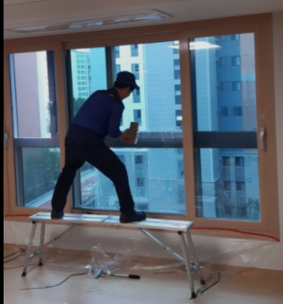
DANA KOREA CO., LTD
B. OTHERES
UV
99%
- WaTouch Film blocks 99% of UV rays.
IV-2-3. How To Use(Installation) _ WaTouch Film
* Notice: Before following below steps, please clean the window first, for
better attaching result.
Step 1.
- Spray water to the window
overall.
Step 2.
- Attach the sheet from the top
to bottom after measured.
Step 3.
- Remove the air bubble with
Push stick, Cut off the remaining
film with box cutter.
Step 4.
- Expert is Required to fix the
WaTouch Film with Silicone at Edges
Or
- Without Silicone fixing, WaTouch Film will wear out after few months and Film can be Re-attached same as first installation.

Slide 11
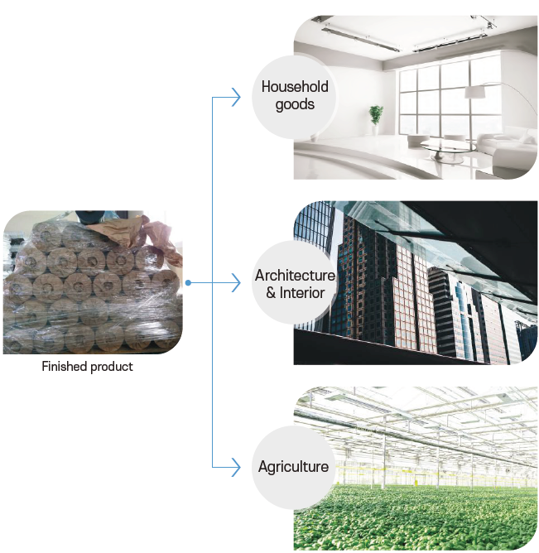
DANA KOREA CO., LTD
V. Produced SIZES
Product Name | SIZES
EZI Sheet | Thickness | Width | Length
 | 0.21mm | 450cm(=177 in) | 2.1m or 5m (83 in or 197 in)
 |  | 900cm(=354 in) | 5m or 7m (197 in or 276 in)
 |  | 1000cm(=394 in) | Max 120meter(4,724 in)
WaTouch | 0.15mm | 1000cm(394 in) | Max 120meter(4,724 in)
 |  | 1200cm(=473 in) | Max 60meter(2,362 in)
VI. Business Area

Slide 12
DANA KOREA CO., LTD
VII. Produced SIZES
* Test Reports
Item | Unit | Test Results | Remark
Visible light Transmittance(VLT) | % | 81.9 | (23+/-2)℃ (65+/-5)% R.H.
U - Value | W/m2K | 5.88 | (23+/-2)℃ (65+/-5)% R.H.
UV Transmittance | % | 0.6 | (23+/-2)℃ (65+/-5)% R.H.
Shading coefficient | - | 0.5 | (23+/-2)℃ (65+/-5)% R.H.
* Test Report of 6 major phthalate free
Test Item | Unit | Test Results
DEHP (Diethyl hexyl phthalate) | % | Not Detected
DBP (Dibutyl phthalate) | % | Not Detected
BBP (Butyl benzyl phthalate) | % | Not Detected
DINP(Di isononyl phthalate) | % | Not Detected
DIDP (Di isodecyl phthalate) | % | Not Detected
DNOP (Di-n-octyl phthalate) | % | Not Detected
* Test Report of 8 major heavy metals hazardous free
Test Item | Unit | Test Results
Lead[Pb] | mg/kg | Not Detected
Cadmium[Cd] | mg/kg | Not Detected
Chromium[Cr] | mg/kg | Not Detected
Barium[Ba] | mg/kg | Not Detected
Antimony[Sb] | mg/kg | Not Detected
Arsnic[As] | mg/kg | Not Detected
Selenium[Se] | mg/kg | Not Detected
Mercury[Hg] | mg/kg | Not Detected

Slide 13
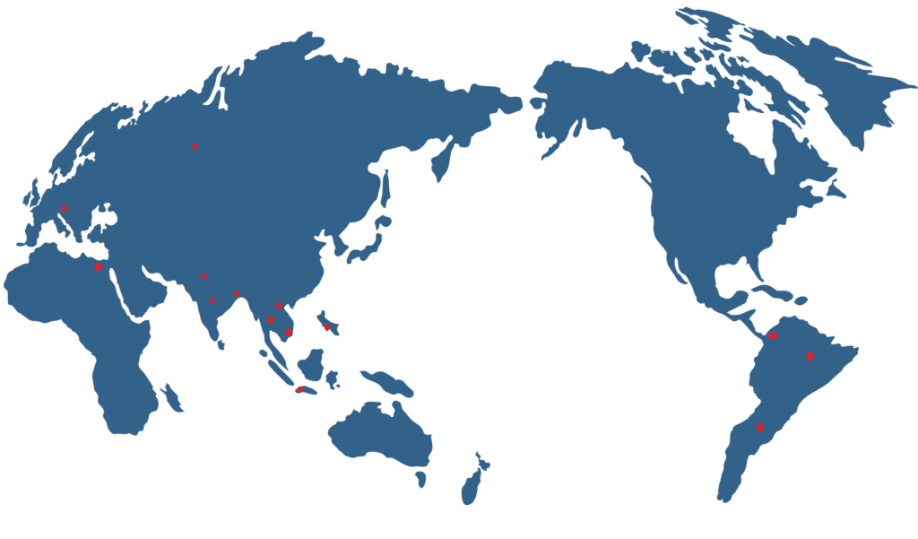












DANA KOREA CO., LTD
VIII. Our Abroad Partners

